Slide 1
6. Text and Files

Slide 2
6. Text and Files
Text
Files
Publish

Slide 3
Text
sprintf
disp
upper, lower, reverse, split, join, splitlines, replace, erase, contains

Slide 4
Files
input, ginput
save, saveas, savefig
load, importdata
cd, pwd, what, which, dir, uigetdir,mkdir, rmdir, copyfile, movefile, delete, uigetfile, Pathes
fopen, fscanf, fprintf, fread, fwrite, fclose
read/writematrix (xlsread/write, csvread/write, dlmread/write)
readvars, readcell, readtable, textscan

Slide 5
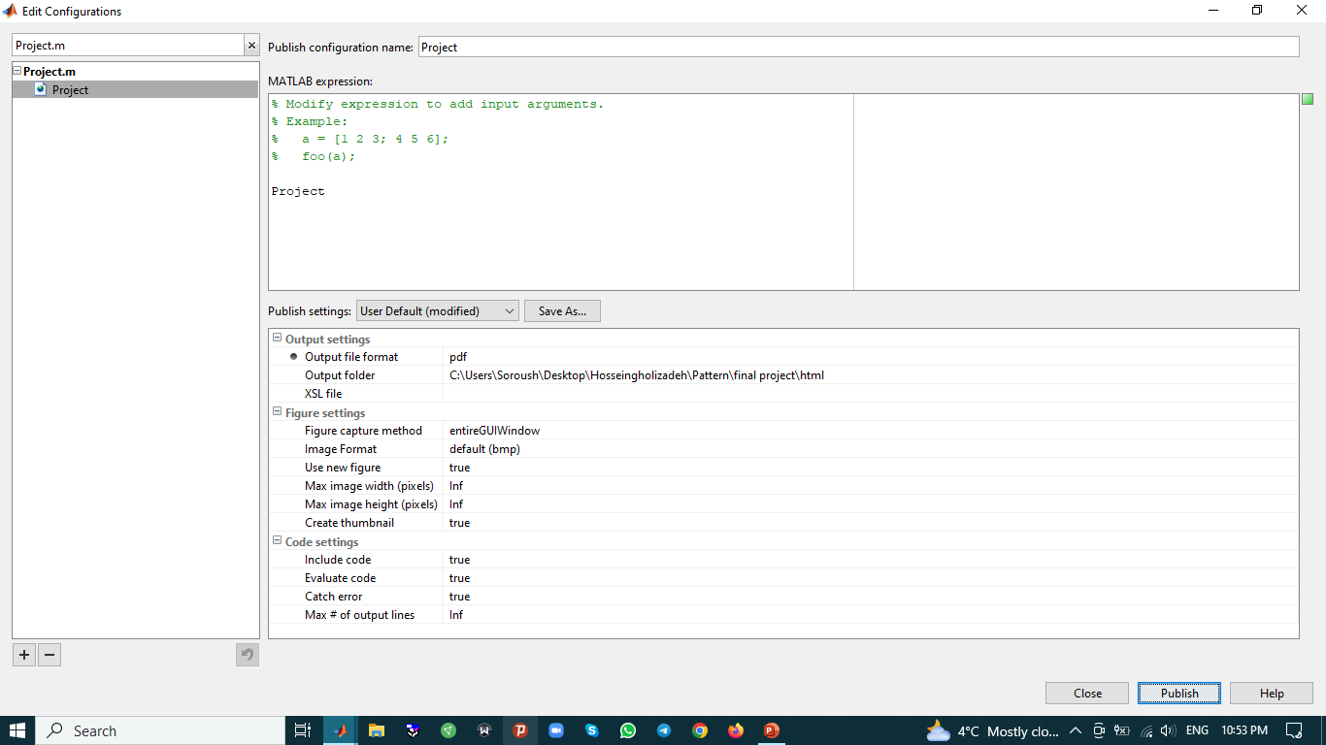
Publish

